Slide 1
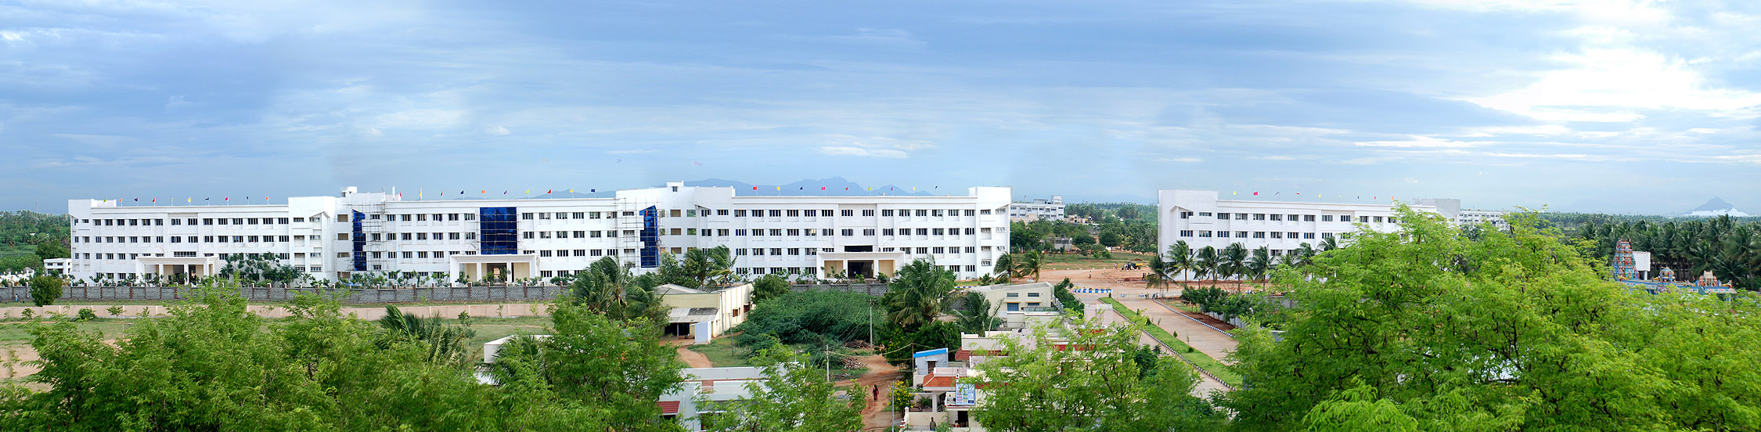
WELCOME TO
DEPARTMENT OF AI&DS
MINI PROJECT EXPO-2026

Slide 2

Accident Emergency Response & Intelligence System
By,
  M. Sabarigiri (920224243048)
  S. Senthamizh Selvan (920224243051)
  S. Venkateshwaran (920224243058)
  S. Nithish (920224243037)
Under the Guidance of
Mr. P. Vasantha kumar.,
DEPARTMENT OF ARTIFICIAL INTELLIGENCE AND DATA SCIENCE

Slide 3
OBJECTIVE
The objective of this project is to develop an Accident Emergency Response & Intelligence System (AERIS) using Deep Learning and Computer Vision to monitor multi-camera video streams (front + rear), detect road accidents in real time, capture accident evidence, and automatically send emergency alerts for rapid response.
By leveraging advanced AI technologies, the project seeks to:
Detect vehicles in real time using YOLOv8.
Track multiple vehicles accurately using BoT-SORT.
Analyze vehicle movements and detect potential road accidents automatically..
Capture accident screenshots and video clips as evidence.
Generate and send instant emergency alerts to the concerned authorities.
AERIS
AI&DS

Slide 4
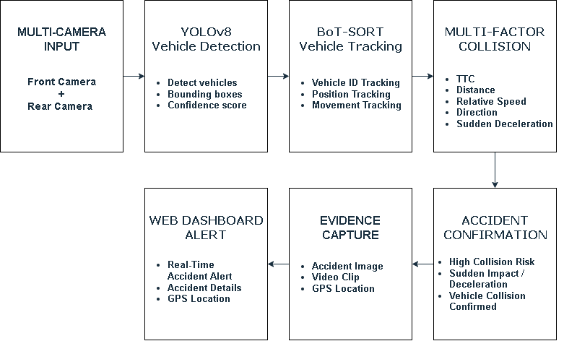
BLOCK DIAGRAM
AERIS
AI&DS

Slide 5
MODULES USED
Input Module – Capture live video stream from the Front + Rear Camera Input.
Video Processing – Preprocess video frames using OpenCV.
Vehicle Detection – Detect vehicles using YOLOv8.
Vehicle Tracking – Track detected vehicles using BoT-SORT.
Accident Detection – Multi-Factor Collision Risk Analysis
Emergency Alert – Generate automatic emergency alerts.
AERIS
AI&DS

Slide 6
TECHNOLOGIES USED
Programming Language – Python
Computer Vision – OpenCV
Object Detection – YOLOv8
Object Tracking – BoT-SORT
Database – MongoDB
Emergency Communication – Web Dashboard Alert
AERIS
AI&DS

Slide 7
ADVANTAGES
Real-Time Accident Detection – Detects potential road accidents in real time using multi-camera video streams (front + rear).
Automatic Emergency Alerts – Generates and sends emergency alerts immediately after an accident is detected.
Improved Road Safety – Helps reduce emergency response time and enables faster assistance to accident victims.
Continuous Monitoring – Continuously monitors the road through the vehicle Multi - camera without requiring manual intervention.
AERIS
AI&DS

Slide 8
APPLICATIONS
Private Vehicles – Monitor road conditions and detect potential accidents using an front + rear vehicle cameras.
Public Transport – Improve passenger safety by monitoring buses and other commercial vehicles for accident events.
Highways & Expressways – Detect accidents in real time and enable faster emergency response.
Emergency Response Systems – Provide instant accident information, GPS location, and evidence to emergency services.
AERIS
AI&DS

Slide 9
Future Enhancement
Cloud-Based Monitoring – Store accident data and evidence securely in the cloud for remote access and analysis.
Mobile Application – Develop a mobile app for instant accident notifications, live status, and location tracking.
AI-Based Severity Analysis – Analyze accident severity using advanced deep learning techniques and vehicle movement patterns.
Emergency Service Integration – Integrate directly with ambulance, police, and hospital systems for faster emergency response.
AERIS
AI&DS

Slide 10
SDG GOALS
SDG 3: Good Health and Well-Being.
SDG 9: Industry, Innovation, and Infrastructure.
SDG 11: Sustainable Cities and Communities.
SDG 17: Partnerships for the Goals (Multi-Department Collaboration)
AERIS
AI&DS

Slide 11
Thank you
AERIS
AI&DS

